Slide 1

An Eye for Excellence
Aspiration and Ambitions

Slide 2

About
Excent Animation was and is a constant evaluation.
It is the outcome of a young entrepreneur, who firmly believed in the limitless confidence of a client and immersed himself in work, to arrive at an interesting juncture.
The company was formed much later …..
….. In June 2017.

Slide 3
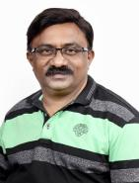
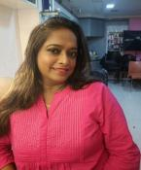
About Promoters
Vilas Rane Vaishali Rane
Overall Experience of 26 + years Overall experience of 18 + years in various
Of which 12 + years in Media & Entertainment Industry. Departments of Media & Entertainment Industry
Film Restoration. Content Processing, Authoring. Q.C. With Excent Animation Studios since last 6 years
Transcoding, Editing, 2D, 3D Animation etc.
Worked in various studios across Mumbai. To name a few.
“Digital Canvas India Ltd”
“Digital Media Imaging Ltd”
“Reliance Media Entertainment Works Ltd”.
“ Ultra Media Entertainment Pvt Ltd”.

Slide 4
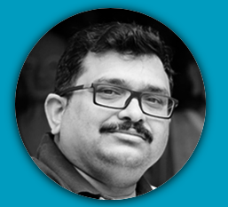

Our Inspirations
Ritanshu Phalkhe
Mentor – Business Development
Rahul Patil.
Mentor - Creatives
Is a familiar name in Indian world of animation.
With 6 Theatrical movies and over 15000 minute of 2D TV Series delivered, he is the name relied upon when it come to delivery and client interface.
His 35 years in the industry is a guiding beacon for us.
Is a well known name of Indian animation industry Has strong 20+ years of experience in film, television, games. Worked in numerous studios of India and Australia like. Big Animation, Reliance Media Works, Jadoo Works. Luma Pictures and many more.

Slide 5

Successful Deliveries
- Before Formation of Excent
Our very first project
3D Movie
53 Minutes
12 Months Delivery
New Rigs, Rig Modification, Animation Lip sync FX etc.

Slide 6

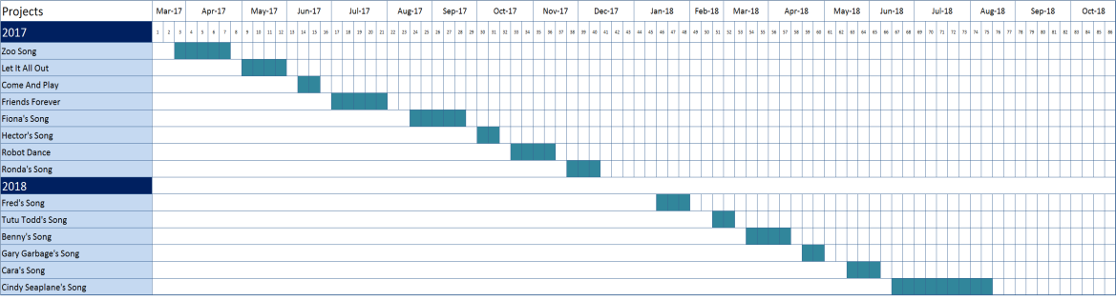
Successful Deliveries
After formation of Excent
Music Videos for You Tube.
Zoo Song.
Let It All Out.
Come & Play
Friends Forever.
Fiona’s Song.
Hector’s Song
Robot Dance
Ronda’s Song.
Fred’S Song.
Tutu Todd’s Song.
Benny’s Song.
Gary Garbage Song.
Cara’s Song.
Cindy Seaplane Song
Highlights
Constantly Engaged
Highest Efficiency Project After Project
Quick Adaptation to new story

Slide 7


Ambitions
We have been sensing for sometime now that it is TIME to explore the world
We decided to focus on what we gained and focus on expertise built…..
. . . . . . . . . .
Europe
Cost
Experts
Pre School

Slide 8
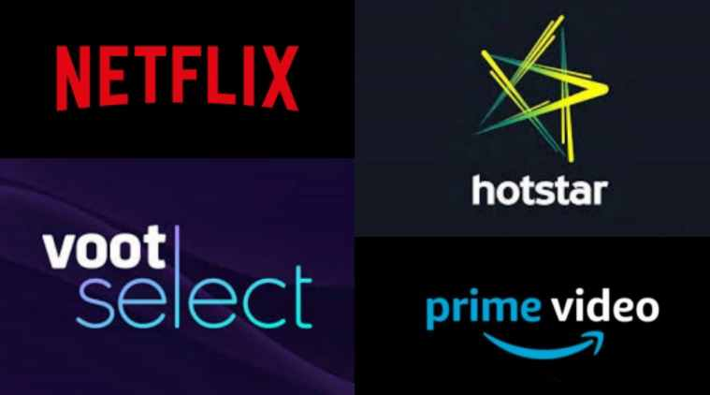
For long we had dreamt of entering the mystical world of Motion Graphics, VFX, Hardcore broadcast creating film promos, trailers etc.
Eyeing the future growth of Post Production Services with launching of new Digital steaming services / Channels in the entertainment world for Web Series, movies, TV Shows etc. the requirement of skilled work force is bound to increase & to meet new challenges everyday, we decided to look out for expert teams who were already into Post Production & willing to move with us. Luckily we found our ex-colleagues from Reliance Media Works.
Today we are associated together to surge ahead & achieve what we had dreamt.

Slide 9
Studio Structure
Production
Creative
Technical
Execution
Production Coordinator
Supervisor Pipeline
Team – Animation
Team – Post Production
Team Comp and Render

Slide 10
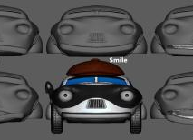

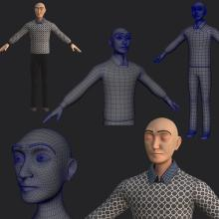
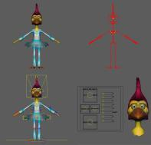
Specializations | Animation Service
Modeling
Blend Shape
Texturing
U V Mapping
Asset Building | Look Development
Rigging

Slide 11
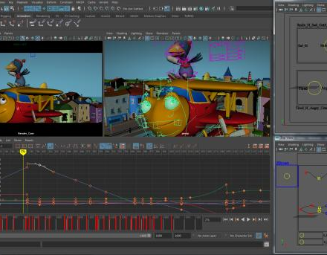
Specializations | Animation Service
Staging/
Blocking
3D Animation
Lighting
Compositing
Animation
Rendering

Slide 12
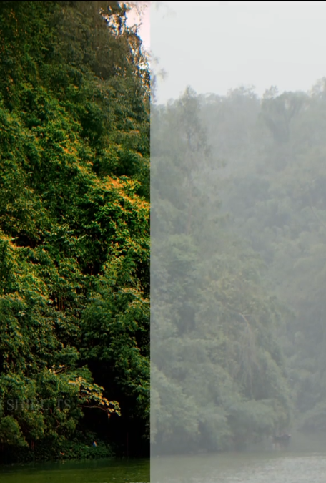
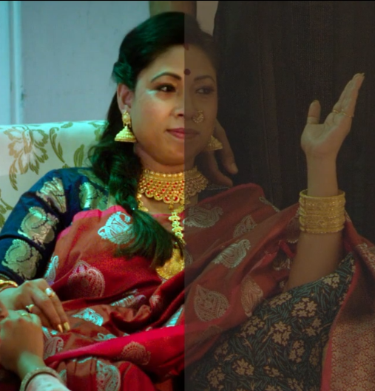

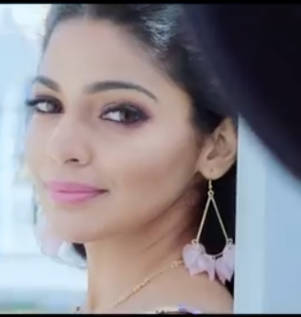

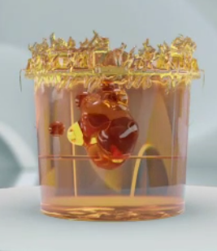
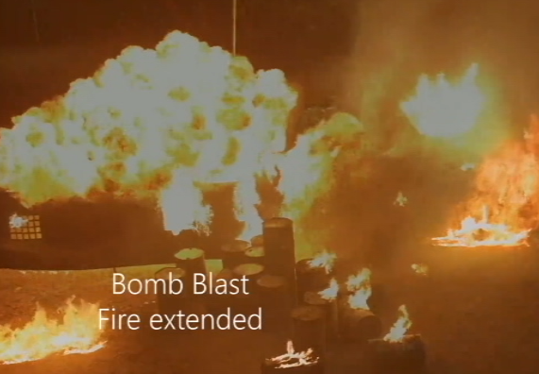

Face Clean Up
D.I.
D.I.
VFX
Specializations | Post Production Services.
GRAPHICS
D.I

Slide 13
What do we want to be….!!!
An Animation home to European and Scandinavian as well as India.
Post Production Services here in India & would certainly love to work on International Projects too.
Because we can …
    Add value to the storyboards and animatics.
    Adapt initially developed rigs to full blown animation needs.
    Improve initially developed sets
    See how the initial designs shape up and appear as a package in 3D
Because we know …
    The subtilties of preschool animation
    Expert manpower well versed with Pre-school Animations for last 7 years.
YOU DREAM WE CREATE …
That’s where our WORK strength lies.

Slide 14
And Hence Europe for Animation
First client from Sweden
(Scandinavia)
Kid-e-Media Studios
Formerly Rutta Ett Studios
In association with
(Simba Dickie Group).
Germany
In a Way we have become European.
We are well versed with European
  interface
  communications
  Data exchange
  Management
  Creative though Process
  Mind Set
  Dos and Don’t
  Colour Sense
  Expressions
  Humour
  Time Line
  Delivery Pressure
  Understanding Corrections
  Reading board
  Understanding needs of European Children
  Subtilties in Animation
  Smooth movements
  Controlled effects

Slide 15
Why Select Excent?
Honesty
Transparency
Focus
We have learned and adapted these 3 business values which are the building blocks of long term and repeat clients

Slide 16
Excent | Team and Capacity
4
Manpower can be increased as per need. City of Mumbai provides ample skills in animation as well as Post Production Work.
Senior Animators
1
6
Business Development
Creative Director
VFX Artist
D.I. Artist (colorist)
Roto Artist
Graphic Designer
Editor
Compositor
2
Junior Animators
Directors

Slide 17
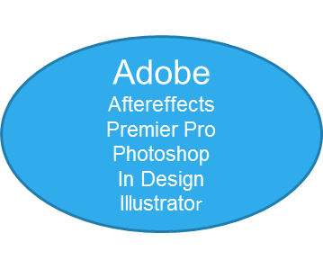



Excent | Trade Tools
Maya
2016 2017
Adobe
Flash
Animate
Audition
Nuke
Mocha
Silhouette
Arnold
V Ray
Resolve
Base light

Slide 18
Excent | Future Irons in Fire
In addition to 2D & 3D Animations services with our existing clientele we have plans to continue Post-Production services with our new clients.

Slide 19
Ladies and Gentlemen
Thank you for your time
And Do please reach us….
Director - Vilas Rane
Call:- +91 75079 07231. +91 82087 15434.
email - ranesvilas@gmail.com
ranevilas@excentanimation.com
Director - Vaishali Rane
  Call:- +91 9920159955
  email - vaishumakeup@gmail.com
You can also reach us at
info@excentanimation.com
Office : B-403. Minerva Heights. Nahur Road. Mulund (West) Mumbai-400080.

